Slide 1
Stellar analysis system (SAS*) WP370
T. Appourchaux
Institut d’Astrophysique Spatiale, Orsay
*SAS= Special Air Service or Son Altesse Sérénissime

Slide 2
Plan
The core programme
PDAS structure
Data products
Work packages and activities
Summary

Slide 3
The core programme
Sample 1: 20 000 dwarf and subgiant stars later than spectral type F5. (m < 11)
Sample 2: 1000 dwarf and subgiant stars later than spectral type F5. (m < 8, long duration)
Sample 3: 3000 dwarf and subgiant stars later than spectral type F5. (m < 8, step-and-stare)
Sample 4: 10,000 cool M dwarfs (m <16, 5,000 in long observations; m<15 5000 in step-and-stare)
Sample 5: 245 000 dwarf and subgiant stars later than spectral type F5.

Slide 4
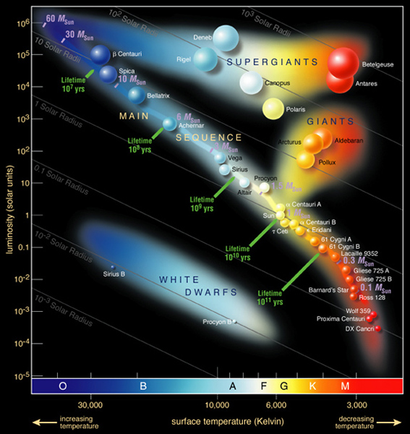

Slide 5
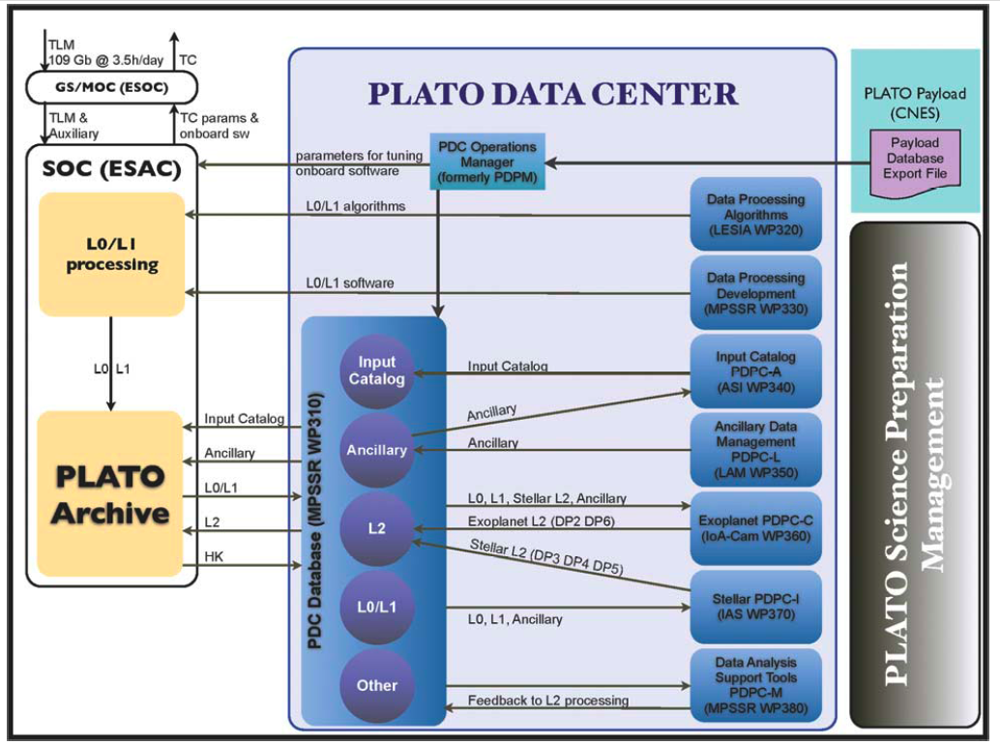
L1⁻:Transit removed

Slide 6
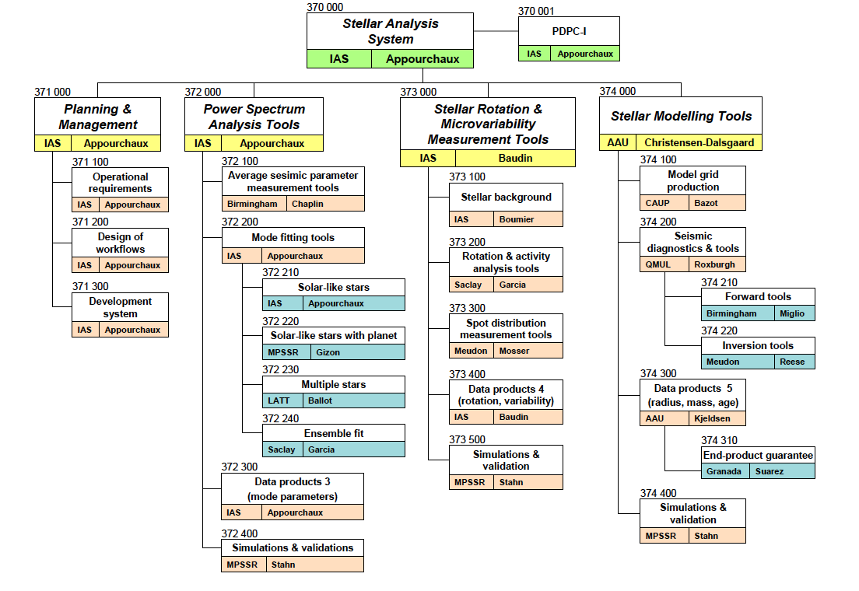

Slide 7
SAS tools
Power spectrum analysis
Av. parameters
DP3
Fit parameters
Light Curves
Stellar grid models
Stellar modelling
Ancillary
DP5
Inversions
Input Physics
Rotation / activity
Spots distribution
Low freq. analysis
DP4
Quality / validation
Activity levels

Slide 8
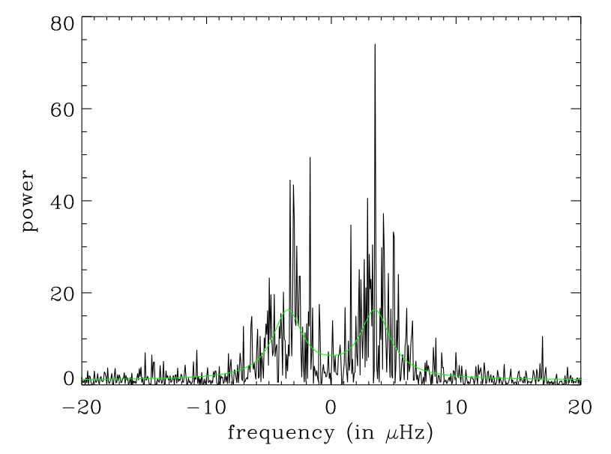
Power spectrum fitting

Slide 9
Stellar Products (DP3)
Solar-like pulsators: freq., ampl., lifetimes, degree, splitting, inclination angle, large freq separation, small freq separation,...(+errors)
Red giants: same as above + sine wave
Solar twins
Solar-like stars with planets (inclination,...)
Open clusters: simultaneous fit (same age, same composition)
Targets not included:
Classical pulsators

Slide 10
DP3 implementation
Input required from Stellar Science (M.-J.Goupil)
Ingest L1 data (compare with L1⁻ data)
Solar-like pulsators: Fourier, Classical MLE, Bayes if S/N low
Solar twins: same as solar-like
Solar-like stars with planets (inclination,...): a drop of Bayes
Open clusters: simultaneous MLE fit
Product and quality assurance
Targets not included:
Classical pulsators

Slide 11
Power spectrum analysis
Av. parameters
DP3
Fit parameters
Rotation / activity
Quality / validation

Slide 12
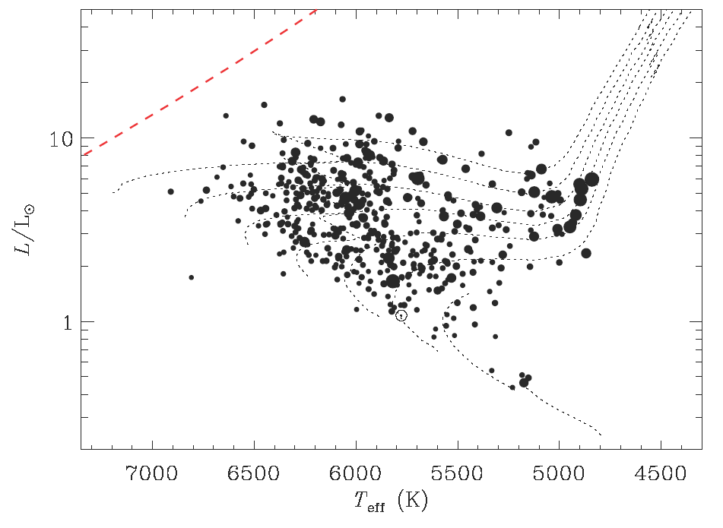
The example of Kepler
Automatic fitting of solar-like stars

Slide 13
Stellar Products (DP4)
Input required from Stellar Science (M.-J.Goupil)
Stellar rotation and activity:
rotation
spot modelling
inclination
Stellar noise: granulation(s), Harvey-like model
Input to power spectrum fitting

Slide 14
DP4 implementation
Input required from Stellar Science (M.-J.Goupil)
Ingest L1 data
Stellar rotation and activity:
low frequency periodicity
follow-up required ? (Doppler imaging)
Stellar noise: granulation(s), Harvey-like model
Related to DP3
Product and quality assurance

Slide 15
Power spectrum analysis
Rotation / activity
Spots distribution
Low freq. analysis
DP4
Activity levels
Quality / validation

Slide 16
Stellar physics (DP5)
Take DP3 and DP4
Ingest ancillary data:
Basic stellar properties, ...
GAIA paralaxes
Rotational / Activity age
Stellar age, mass, radius
Inclination / rotation
Differential rotation
Composition
Structure (convective core,…)

Slide 17
DP5 implementation
Input required from Stellar Science (M.-J.Goupil)
Grid of models
Criteria for agreement
Surface effects (what do we do?)
Different models...
Different oscillation codes
Product and quality assurance

Slide 18
Power spectrum analysis
Av. parameters
DP3
Fit parameters
Stellar modelling
Stellar grid models
DP5
Inversions
Rotation / activity
Spots distribution
Low freq. analysis
DP4
Quality / validation
Activity levels

Slide 19
Activities
Definition:
Until June 2011, then December 2011 if selected
Implementation:
From 2012 to end 2018
Operations:
From 2019 to 2023

Slide 20
Summary
Close link with with Science WPs
Stellar Analysis System will implement codes for fitting spectra; extracting activity / rotation; stellar mass, radius of the PLATO samples
Code mainly dedicated to solar-like oscillations
Free to set up our own center for taking care of the other stars (classical pulsators for instance)

