Slide 1
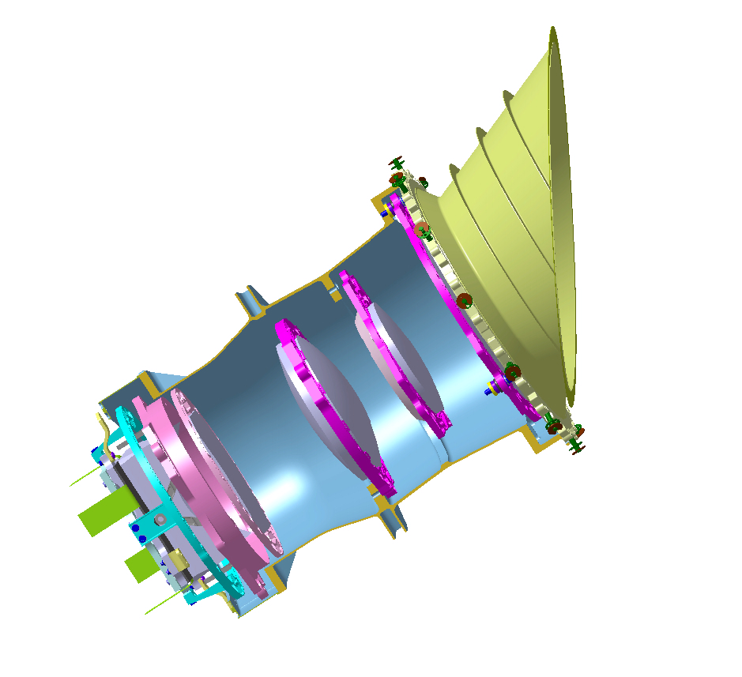
Roberto Ragazzoni
INAF – Astronomical Observatory of Padova
roberto.ragazzoni@oapd.inaf.it
PLATO: the TOUs
(Telescope Optical Units)
Kick Off Meeting KOM-Paris, November 9 2010
On behalf and with extensive inputs from the Telescope Group (D. Magrin, D. Piazza, W. Benz, J. Farinato, S. Basso, M. Ghigo, M. Munari, P. Spano’, G. Piotto, M. Barbieri, E. Pace, S. Scuderi, I. Pagano, L. Gambicorti, C. Arcidiacono, R.U. Claudi, V. Viotto, M. Dima, G. Gentile, R. Canestrari, S. Desidera, S. Benatti)

Slide 2
Optical Design guidelines
A number of relatively small telescopes with very large FoV
Initially 500 sq. degrees, now approaching more than twice…!
Very high stability of the image (jitter sensitivity)
Nicer to have a larger aperture but not too much
Robustness of the design (on the other hand we have to do several…)

Slide 3
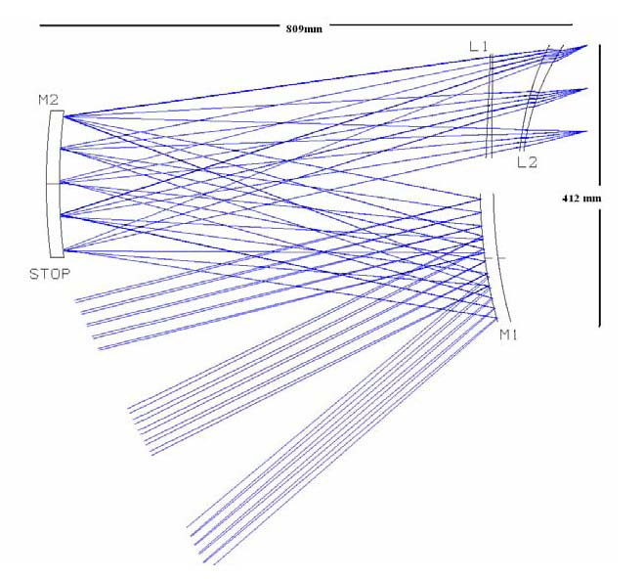
The initial baseline design…
500 square degrees
with 12.5arcsec px size
Uhmmm…. Looks very familiar!
(WAC onboard Rosetta reminiscence)

Slide 4
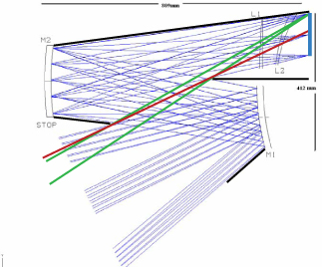

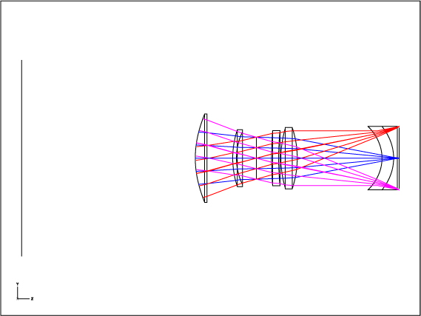
Initial baseline design…
Our first attempt…
809 mm
809 mm
437 mm
192 mm
412 mm
5 lens +/- 1
Two aspherics surfaces
CaF₂
SF15
LASF35
CaF₂
CaF₂
Jitter sensitivity is much
larger with reflective
elements rather than
refractive ones!
2 symmetric aspheric surfaces (K,a⁴,a⁶)

Slide 5
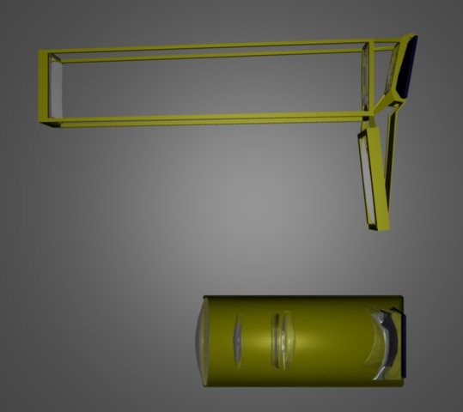
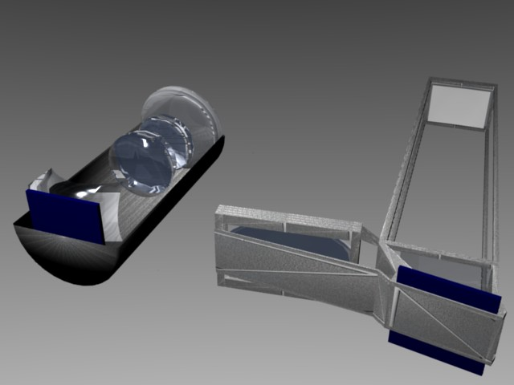
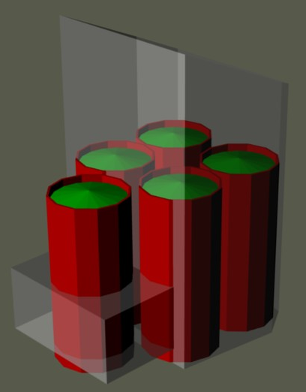
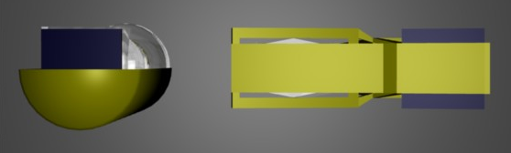
Comparing volumes…
A packing ratio
of 5 to 1…

Slide 6
Optical design evolution…
Several (about 20) meetings in Europe
The pushing from scientists toward large aperture and larger FoV (within the mass and volume constraints) mostly accomplished by a factor 2
While a lot of designs flow around only a few were named as “current baseline”in the consortia
Industry findings and ESA endorsement confirmed our –all refractive- approach.

Slide 7
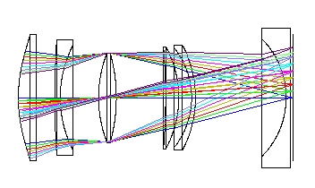
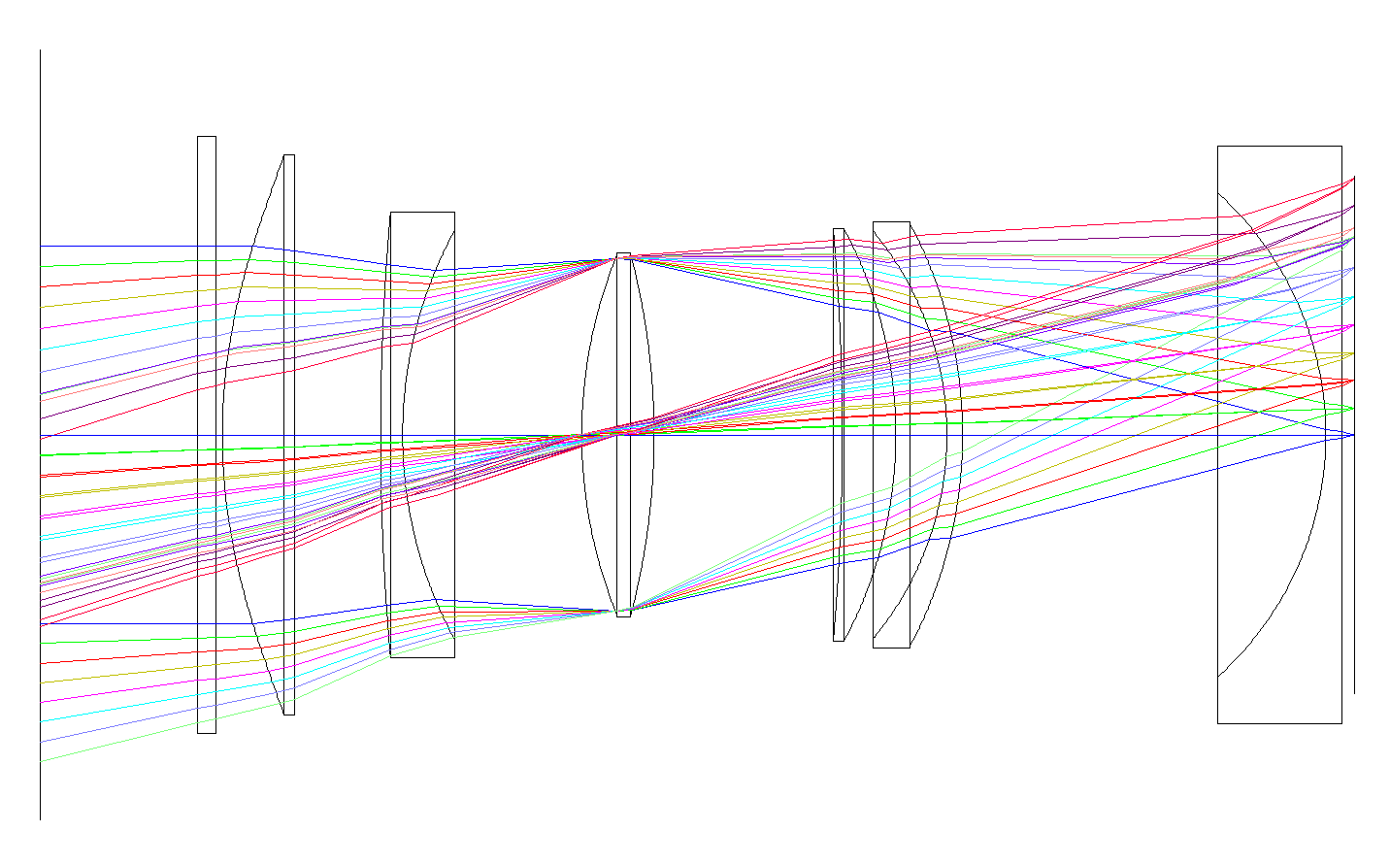
Evolution with time (and meetings)
Time

Slide 8
Evolution with time (and meetings)
Aspherics drop to 1
BaF2 disappears
CaF confined to small
and non thermal-critic lens
One window in front of 6 lenses
Pupil size grows to 120mm
Field of View increased to
Time

Slide 9
Evolution with time (and meetings)
Aspherics drop to 1
BaF2 disappears
CaF confined to small
and non thermal-critic lens
One window in front of 6 lenses
Pupil size grows to 120mm
Field of View increased to
Easier
to do
Time

Slide 10
Evolution with time (and meetings)
Aspherics drop to 1
BaF2 disappears
CaF confined to small
and non thermal-critic lens
One window in front of 6 lenses
Pupil size grows to 120mm
Field of View increased to
Longer
duration
Time

Slide 11
Evolution with time (and meetings)
Aspherics drop to 1
BaF2 disappears
CaF confined to small
and non thermal-critic lens
One window in front of 6 lenses
Pupil size grows to 120mm
Field of View increased up to 40º
Even better science!!!
Time

Slide 12
The reference design
(frozen in CNES Oct 8th 2010)
Total mass of lenses ~5kg
Total mass of lenses ~5kg
Window
BK7 G18
368 mm
FPA
192 mm
CAF2
N-KZFS11
S-FPL53
KZFSN5
S-FPL51
BK7 G18

Slide 13
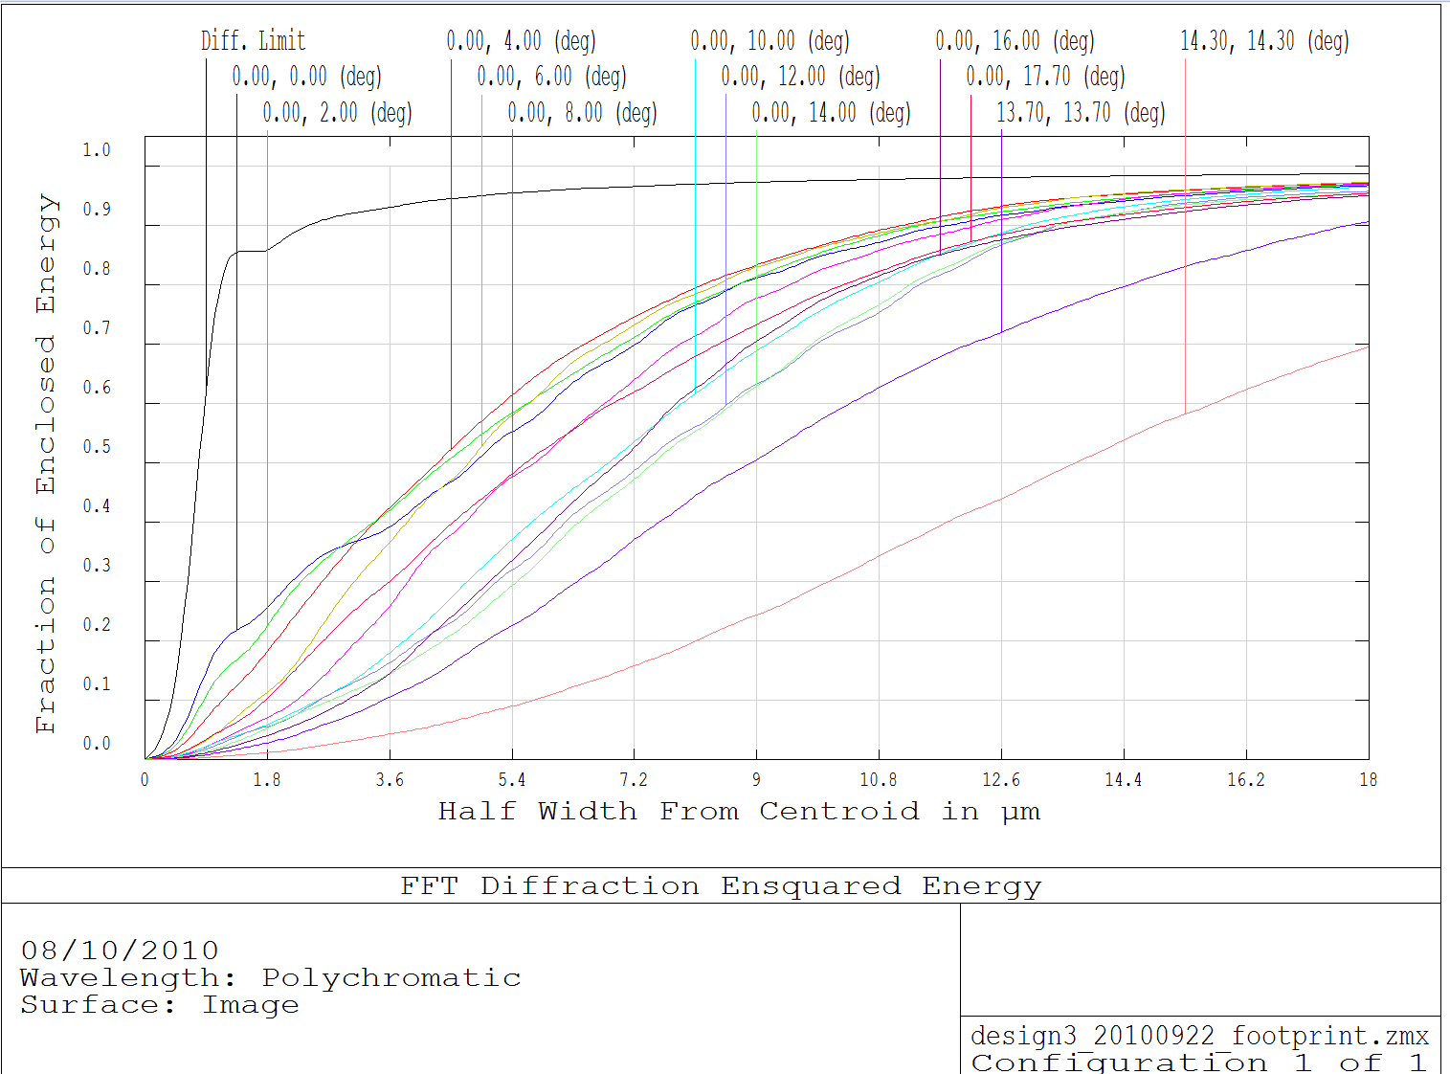
The reference design
(frozen in CNES Oct 8th 2010)
40.3deg FoV
Window
BK7 G18
35.4deg FoV
38deg FoV
368 mm
Corrected FoV ~ 1108 degree²
FPA
192 mm
CAF2
N-KZFS11
S-FPL53
KZFSN5
S-FPL51
BK7 G18

Slide 14
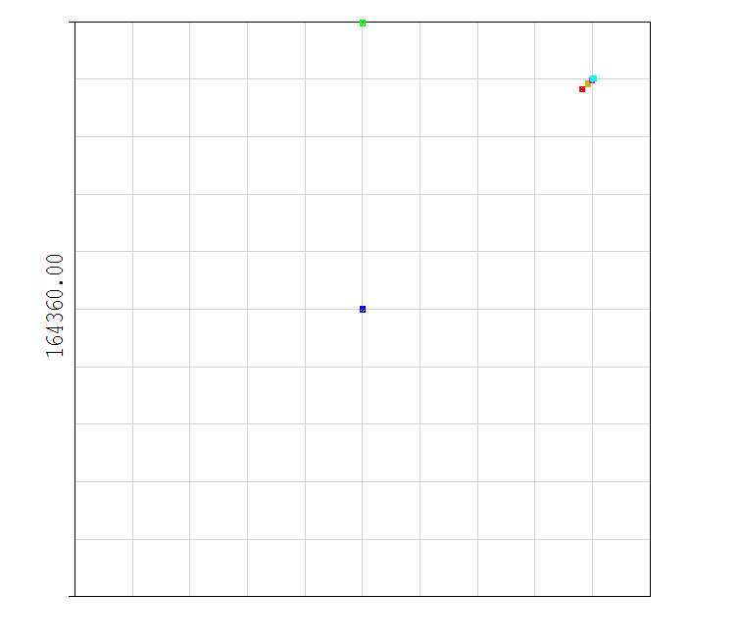
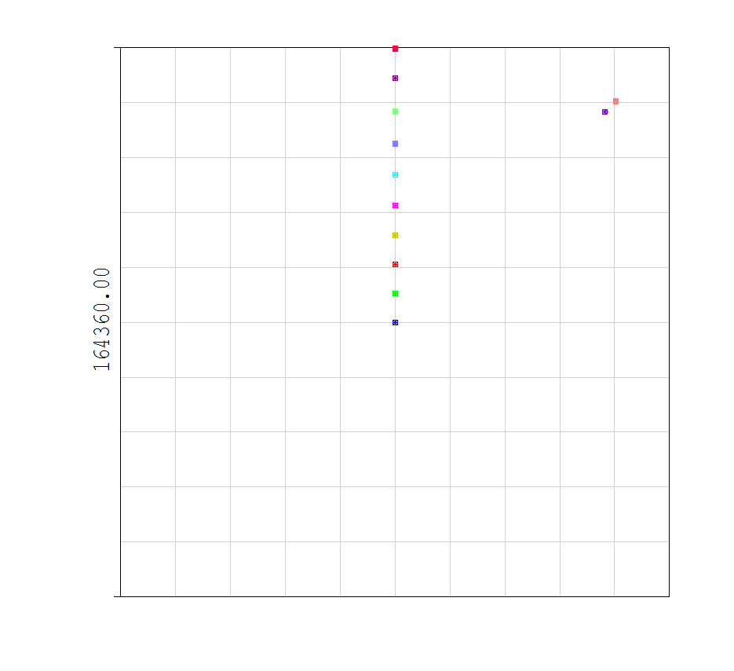
The reference design
(frozen in CNES Oct 8th 2010)
90%EE<30×30 arcsec² ~ 2×2 pixels²
90%EE<37.5×37.5 arcsec² ~ 2.5×2.5 pixels²
90%EE<45×45 arcsec² ~ 3×3 pixels²

Slide 15
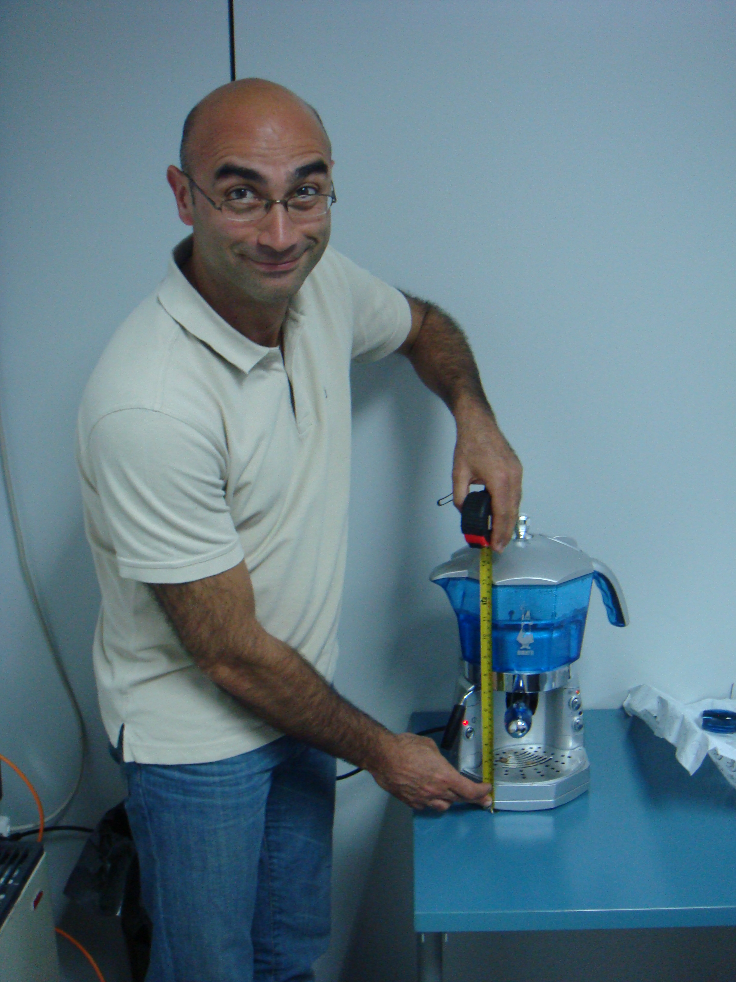
Physical size of the TOU…
Surprised???
On the other hand it is a true italian design…!!!

Slide 16
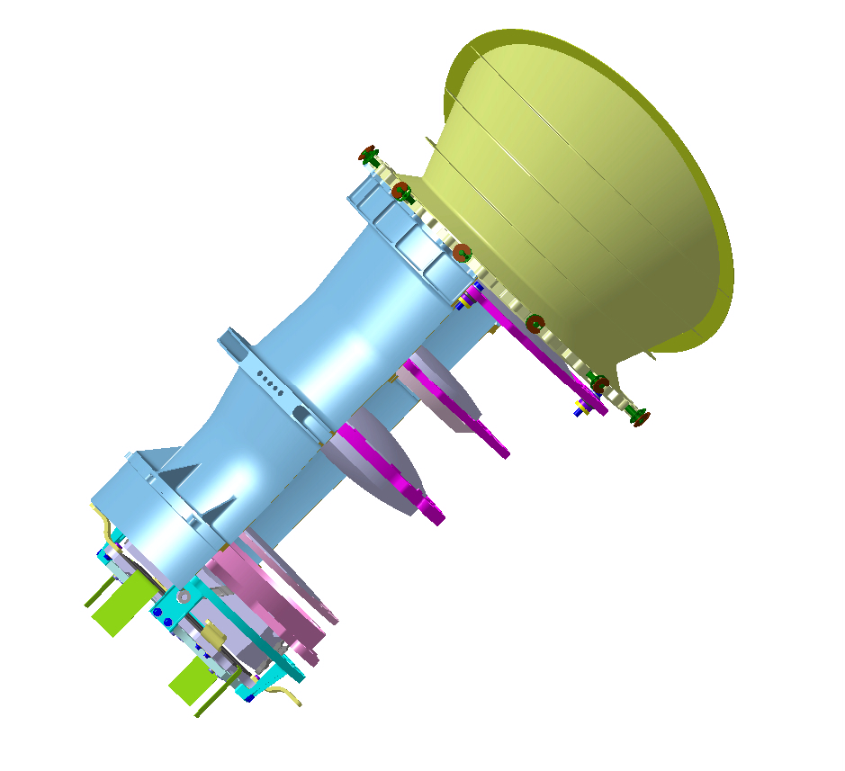
A mechanical enclosure…

Slide 17
A mechanical enclosure…
Flexible mountings
Shims for alignment

Slide 18
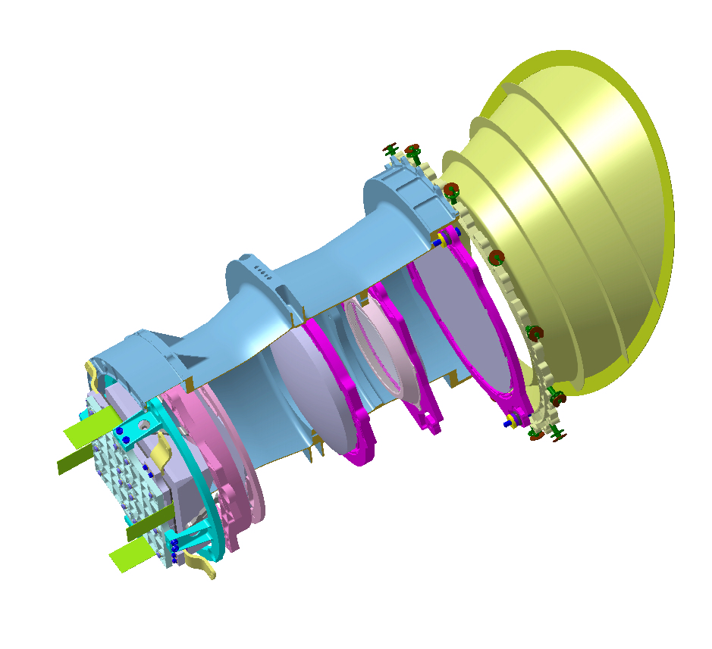
A mechanical enclosure…
Spherical washers
Stop fixed with 6 screws

Slide 19
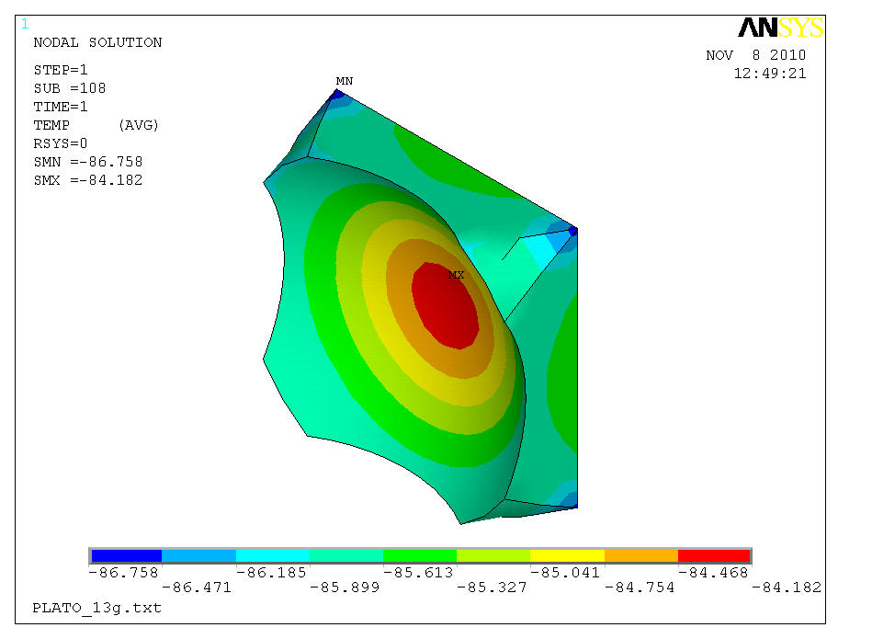
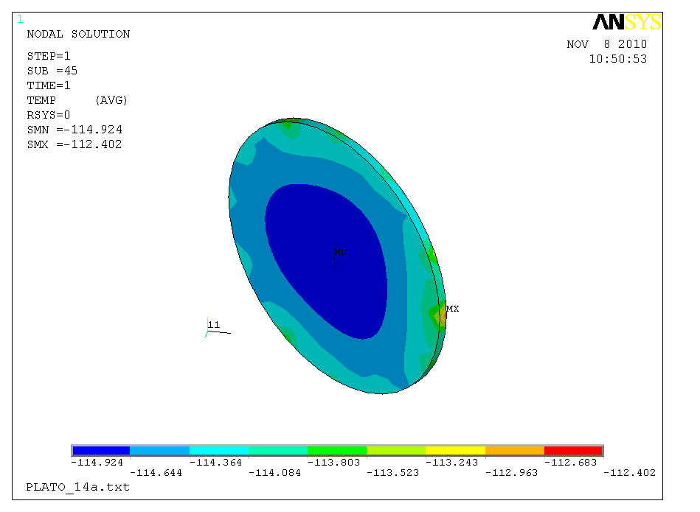
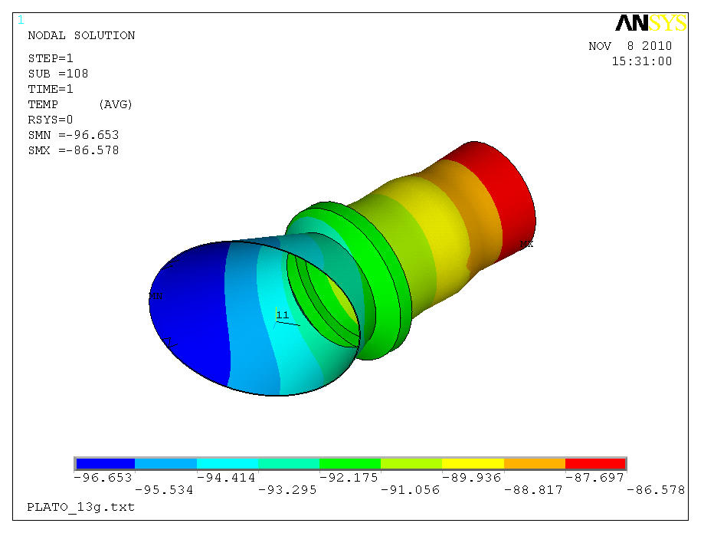
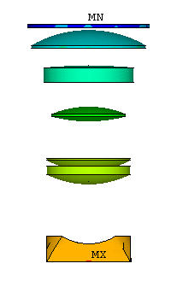
Thermal analysis

Slide 20
Full throttle now… (we want to fly!)
Assessment of a number of details (tomorrow afternoon..)
Having a breadboard with almost finalised lenses and structure thermally mimicing the final one (this morning coffee break…)
Characterizing CaF2 blanks in launch and space environment
Keeping several B-plans ready just in case
And more…

Slide 21
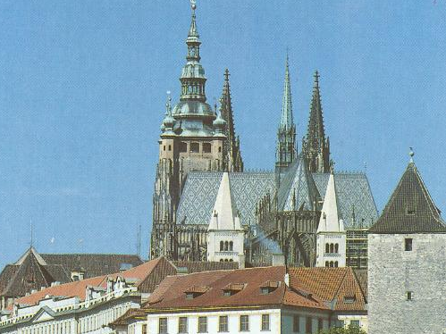
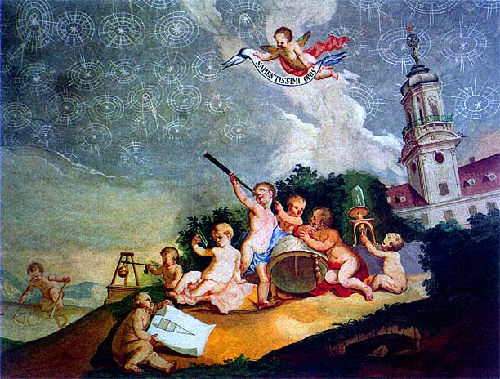
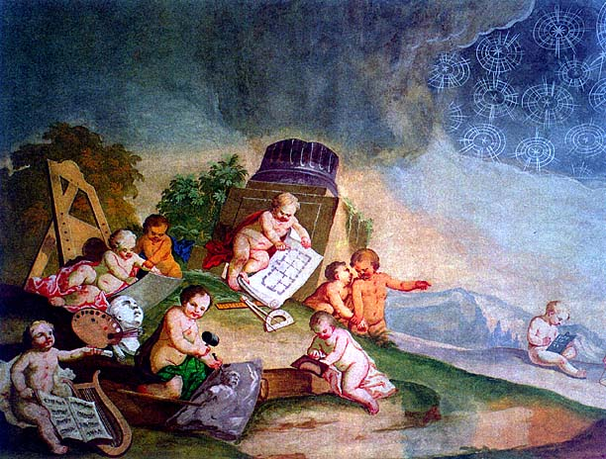
Prague
Castle’s library
Unknown, 1740 (?)
Extra-Solar
Planets

Slide 22
Good luck provider
Prague
Castle’s library
Unknown, 1740 (?)
Observing group
Calibration team
Compliance assurance
Optical design
Thank you
for your
attention…
Management
Manufacturing

